Slide 1

GUARDIAN
LIFE INSURANCE LTD.

Slide 2
In the year of
2014
We started our journey

Slide 3




Journey Started
1st January, 2014
With some visionary people to change the face & perception of the industry
Apart from the below mentioned sponsors, we have 11 more institutional and individual sponsors/shareholders

Slide 4

Who We Are
Own Head Office (17,000 SFT)
01
54 Regional & Branch Office
64 District Coverage
ISO & LEED Certification
02
AA3 Rating – CRAB
Sadharan Beema Corporation & SCOR as Reinsurer
Policy Bonus to BDT 60 Taka per 1,000 BDT Sum Assured
Our Re-insurers
03
জীবন বীমা কর্পোরেশন
SCOR (world's fourth largest reinsurer)
More About Guardian
04
Auditor - S. F. Ahmed & Co
Company Secretary and External Lawyer - SIA&A
Appointed Actuary - Mr. Gopal V Kumar
Fellow of Institute of Actuaries of India (FIAI

Slide 5
After 10 Glorious Year, in
2023
We Are -
#1 in Group Business
#1 in Term of Management Expense
#1 Among 4th Generation Companies

Slide 6

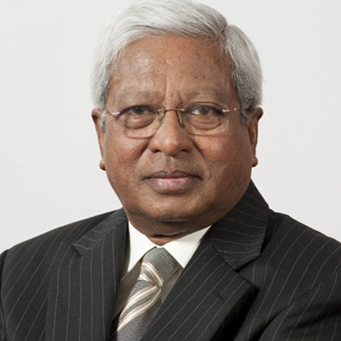
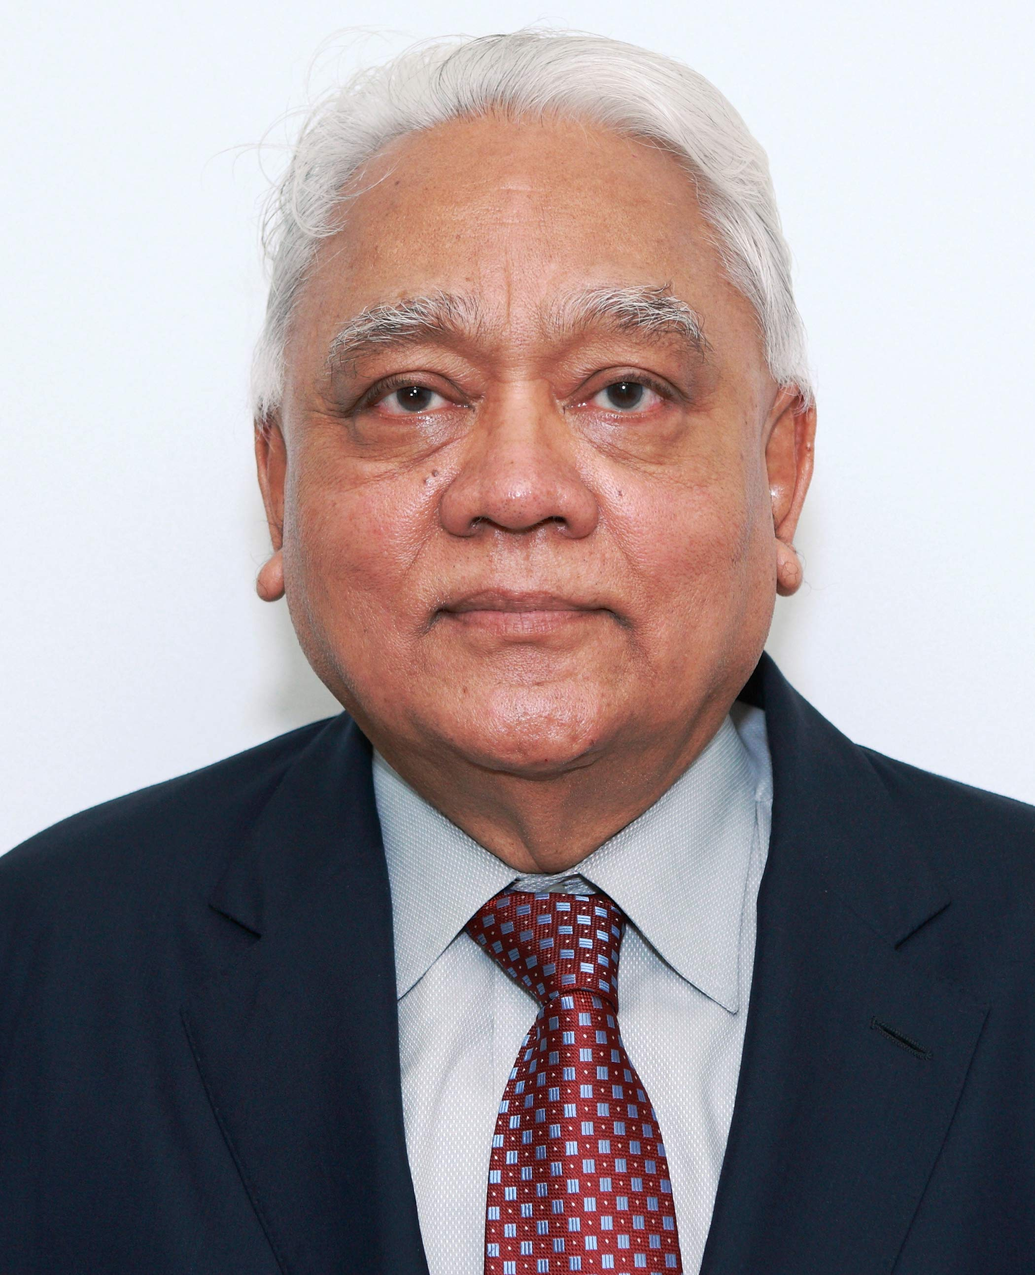
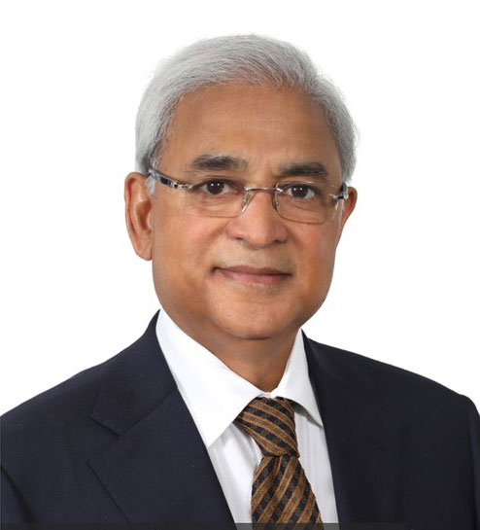
Visionaries of Guardian
Sir Fazle Hasan Abed
Syed Manzur Elahi
Tapan Chowdhury

Slide 7
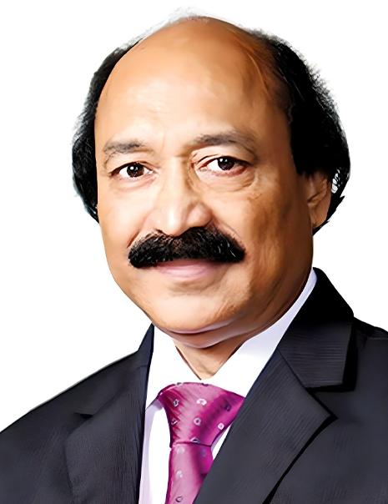
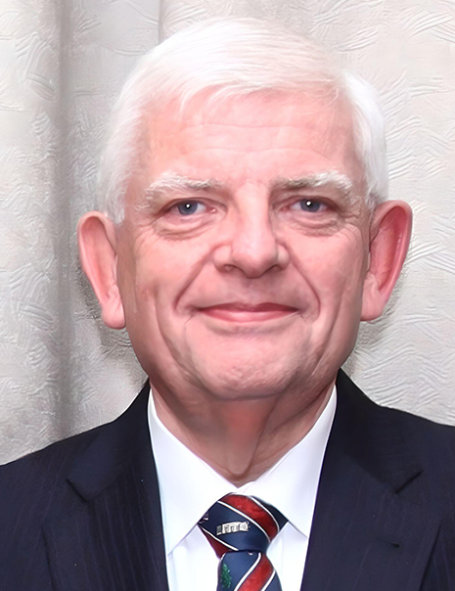
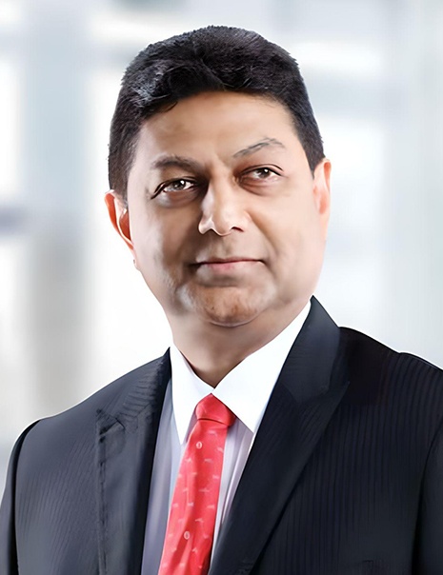
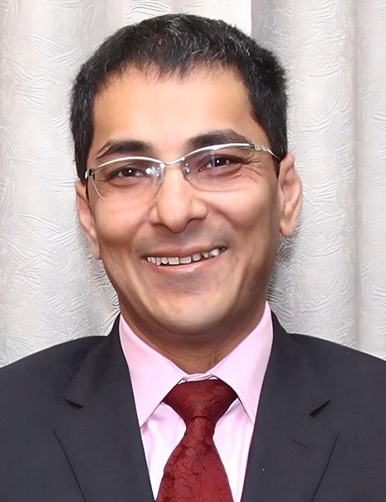
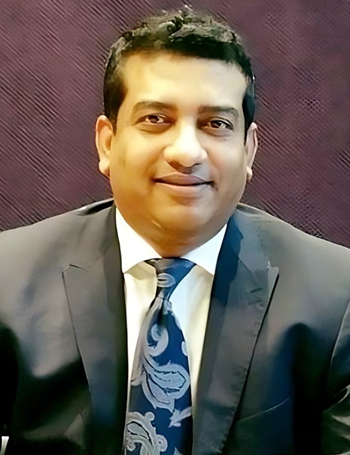
Board Members
Samuel S Chowdhury
Chairman
David James Howard Griffiths Director.
Shiran Harsha Amarasekera
Director
Syed Akthar Hasan Uddin
Director
Mr. Arinjoy Dhar
Director

Slide 8

01
Fastest claim settlement
Our Digital
Services
02
Largest Group Insurance Portfolio
03
Online claim submission
Guardian Life Insurance offers
financial protection against
potential risks & losses
04
Online claim tracking process
12
05
74 branch offices all over Bangladesh.
BEFTN process for claim settlement
11
06
Dr. GUARDIAN:
Emergency doctor consultancy
Health Card
10
07
Dedicated Relationship Manager
09
08
Cashless Ambulance Service
24/7 and 365 days’ call center
Overseas Treatment Facilities

Slide 9
We provide the following Group Insurance Benefits to
Era- Infotech Limited:
Death Benefit
Permanent Total Disability (PTD)
Permanent Partial Disability (PPD)
General In-patient Hospitalization (IPD)
General Out-Patient (OPD)

Slide 10
Death Benefit:
Group Life Insurance coverage provides settlement of Death (due to any reason; sickness or accident) claim up to the sum assured against the Insured Employee or Group Member. The payment will be paid in the event of death of an employee from any cause whatsoever anywhere in the world, except-
The Sum Assured relating to Death Benefits shall not be payable if death is caused due to suicide in the first year of insurance coverage of an Insured. HIV/AIDS related diseases is non-insurable.
Death | Coverage
Benefit Per Employee | 100% Sum Assured

Slide 11
Permanent Total Disability (PTD) Benefits:
If any INSURED employee becomes totally and permanently disabled from bodily injury Benefits are payable in lieu of the Life Insurance benefit.
Permanent Partial Disability (PPD) Benefits:
If any employee becomes partially disabled on a permanent basis, as a result of bodily injury, these benefits are payable in lump sum as per following schedule. Benefits are payable in lieu of Life Insurance benefits as per the Schedule of Benefits.

Slide 12
General Hospitalization / In Patient Benefit
IPD/Hospitalization Benefits | Coverage
 | Plan A | Plan B | Plan C | Plan D | Plan E
Maximum Coverage Per Disability | 4,00,000 | 2,60,000 | 2,20,000 | 1,80,000 | 30,000
Total Hospital Room Rent Limit per Disability | 1,60,000 | 1,04,000 | 88,000 | 72,000 | 12,000
Daily Hospital Room Rent Limit | 12,000 | 7,800 | 6,600 | 5,400 | 900
ICU/CCU Limit per confinement | 14 Days | 14 Days | 14 Days | 14 Days | 14 Days
All other In-Patient treatment expenses inclusive of surgical charges, consultation fees, medicines and relevant Medical investigations related to the ailment and other ancillary services (excluding Room & ICU/CCU charges) maximum per person per disability. | 2,40,000 | 1,56,000 | 1,32,000 | 1,08,000 | 18,000
Worldwide Treatment Coverage: In-Patient treatment facilities outside of Bangladesh are also covered.

Slide 13
General OPD Benefits
General Out-Patient Treatment Benefits,_ Co-insurance: 10% (Ten percent) | Coverage
 | Plan A | Plan B | Plan C | Plan D | Plan E
Maximum Limit per member per Year | 50,000 | 40,000 | 30,000 | 20,000 | 10,000
Maximum Consultation limit per person per year | 15,000 | 12,000 | 9,000 | 6,000 | 3,000
Specialist visit (Actual expenses incurred or maximum per visit) | 1,500 | 1,500 | 1,500 | 1,200 | 1,000
General Practitioner Office or Home visit (Actual or Maximum per visit) | 800 | 800 | 800 | 600 | 500
Investigation limit per person per year | 35,000 | 28,000 | 21,000 | 14,000 | 7,000
Worldwide Treatment Coverage: Out-Patient treatment facilities outside of Bangladesh are also covered

Slide 14
Explanation Of Few Terms:
Designated Hospital shall mean a hospital or clinic with whom the company has entered into an agreement for providing preferential services and Cashless Treatment Facility to its insured employees.
Hospitalization shall mean confinement to a Hospital/Clinic as an in-patient for at least 24 consecutive hours. However, confinement of less than 24 hours due to technological advances for surgical intervention like Phaco-surgery, Cholecystectomy, Lithotripsy etc. shall be considered as hospitalization.
Standard Cost or charge shall mean the charge demanded for various medical services by the company’s designated hospitals of that particular area.

Slide 15
Exclusions For Health:
Any Congenital Infirmity;
Mental, emotional or psychiatric disorders, alcoholism or any other narcotic addiction;
Circumcision, prophylactic, vaccination and immunization procedures;
Obesity i.e., treatment for, or required as a result of obesity, Alopecia, any condition under evaluation;
Any procedures which is experimental or not generally accepted by the medical profession viz. acupuncture, Alternative Medical Care (Homeopathic, Herbal, Ayurvedic) etc;
Any cosmetic skin treatment or plastic treatment/surgery, unless required as reconstructive surgery as a consequence of an injury due to Accidents, burns;
Rest, convalescence or rejuvenation cures, thermal baths, any confinement or treatment for the purposes of slimming or beautification;
Treatment of family planning purposes including willful termination of pregnancy, sterility or treatment related to infertility or Assisted Reproduction Technology (ART);
Attempted suicide, violation or attempted violation of the law, injuries willfully or intentionally self-inflicted or due to insanity or under the influence of a drug;
Routine examination of eye and ear, fitting or replacement of eyeglasses (including contact lenses) or hearing aids;

Slide 16
Exclusions For Health:
Health screening including Routine Examinations (health check-ups, investigations done by self), radiotherapy-X-ray radium or radioactive isotopes treatment (except Hospitalization), chemotherapy or hospitalization due to complication of chemotherapy (except Hospitalization) or any form of treatment when not incidental or necessary to the treatment of the injury/Illness which caused the Hospitalization;
Injury arising due to Accident while participating in any unlawful activities (e.g. driving a car without a license);
Injury or disease directly or indirectly attributed to or caused by war, declared or undeclared, or war like operations or as a result of direct involvement in civil commotion;
Sleep disorders i.e., treatment for insomnia, sleep apnea, snoring, or any other sleep related breathing problem;
Injury, destruction or damage caused by nuclear fission, nuclear fusion or irradiation;
All expenses incurred in connection with the donor for any treatment;
AIDS and HIV diseases, provided that HIV tests are included in the insurance coverage.

Slide 17
Claim Procedure - In Patient Treatment:
When advised by a medical consultant for hospitalization, the Member must inform the Company through- “Claim Intimation Form/Call Center {16622}/Mobile App/Web portal” together with doctor’s advice on or before admission in a Hospital/Clinic.
Use of Designated Hospitals: If a Member is admitted in the company’s designated Hospital/Clinic, the Company shall pay all eligible expenses incurred for hospitalization treatment within his/her benefit limit directly to the hospital/clinic. Any expenses not mentioned in the Benefit Schedule or in excess of the Benefit Limit should be borne by the Member himself/herself and settled with the hospital at the time of discharge.
https://guardianlife.com.bd/preferred-hospital
Use of Govt./Non-Designated Hospitals: The Member shall submit claim through ‘Claim Form’ to the Company within 60 days, after discharge from the Hospital/Clinic for reimbursement of expenses. The Company shall reimburse to the Member the actual expense incurred for hospital treatment up to the benefit limit upon receipt of complete Claim Form along with supporting bills, money receipts and documents.

Slide 18
Necessary Document For Claim:
The Organization shall claim expenses by submitting the prescribed Claim Form to the Company together with supporting documents (duly attested by competent authority) including the followings:
Consultant’s recommendation on prescription for hospitalization.
Copy Discharge certificate (Photocopy).
Copy of investigations reports while hospitalized.
A copy of the patient's file while hospitalized (if possible).
Original money Receipt or Bill of Consultants (Physician/Surgeon) fee
Original bill relating to room charges, investigations and other services where applicable.
Original Bill of medicine/drugs while hospitalized.
Original bill relating to Surgical Operation charges (operation theatre, surgical team, delivery charge, anesthesia & other charges), where applicable (original)
Original Bill relating to ancillary charges (e. g. ambulance service, oxygen therapy, blood transfusions etc.)
The Policyholder shall submit claim through ‘Claim Form’ to the Company within 4 (four) weeks after discharge from the Hospital/Clinic
Note: Photocopy of any money receipt will not be accepted at final settlement of Claim. Writing or any modification by claimant on any claim documents strongly prohibited and if it proven that claim will be invalid. Submission of claim within allowable time is recommended.

Slide 19
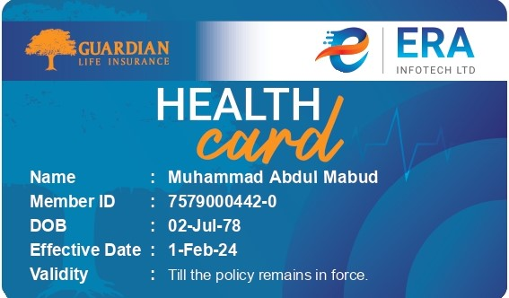
Value Added Service (VAS) of our Medical Insurance Plan:
We provide Health Insurance Card without photograph and contact details for each employee under this plan to get preferred benefits (discount, Cashless facility, priority admission) at our designated hospitals.
Flexibility to choose Doctors or Hospitals/Clinics, countrywide even in abroad (worldwide) but the reimbursement shall be made as per standard cost of such treatments in Bangladesh.
SMS (Text Messaging) for Claim updates.
BEFTN facility for faster Claim Settlement to respective member’s bank account.

Slide 20




Customer Service Touch Points:
Short code – 16622
Long code - 09612316622
24/7 Service
Guardian Live Chat
Available: Website & App
24/7 Live Agent & ChatBot Service
Facebook Messenger
24/7 Live Agent & ChatBot Service
corporatesupport@guardianlife.com.bd
Response within 6 working hours.

Slide 21
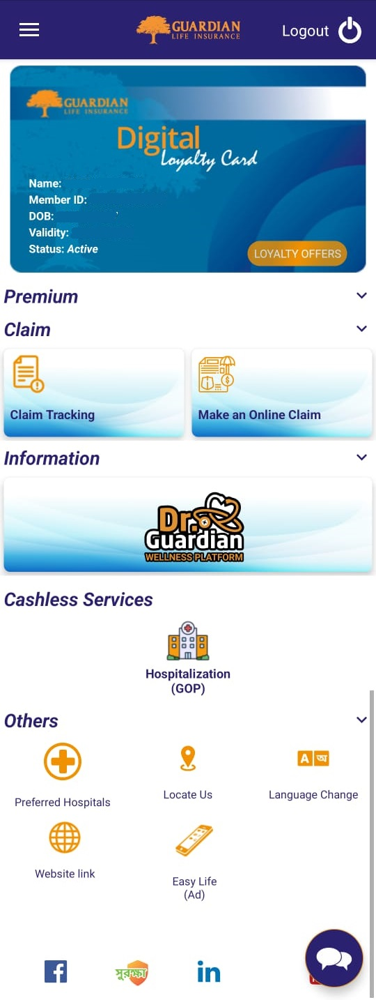

My Guardian App
Now, with the arrival of My Guardian app, all the corporate and individual policy holders can avail the following features:
- Find our preferred Hospitals and Diagnostics.
- Request for Cashless Hospitalization - Make an Online Claim
- Claim Track by unique intimation number and etc.
Claim Tracking
Make an Online Claim
Dr. Guardian Wellness Platform
Make a Cashless/GOP
request Online
GLIL Preferred Hospitals List
(GOP & Discounts)
APK App Link
Live Chat

Slide 22
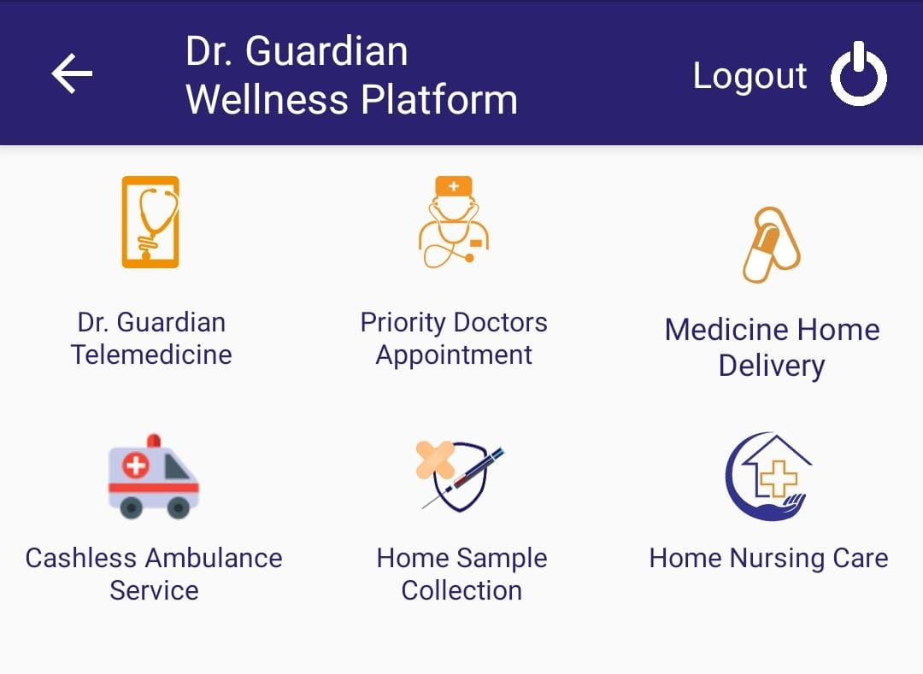
Dr. Guardian Wellness Platform

Slide 23
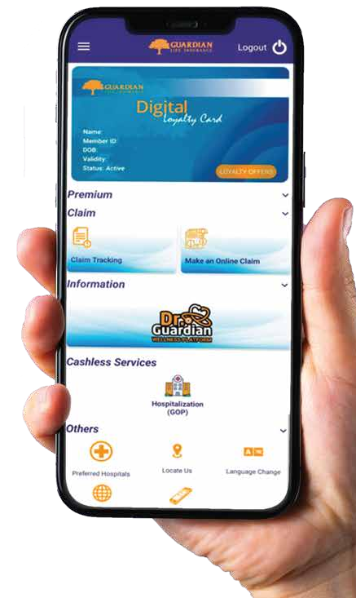
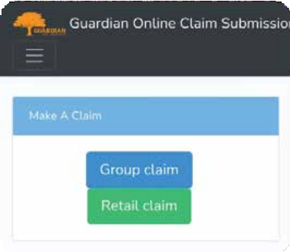

Login for Claim, GOP, Track Claim
Log in as a client From Group Claim with your GLIL member ID ex: 7123456789-0

Slide 24
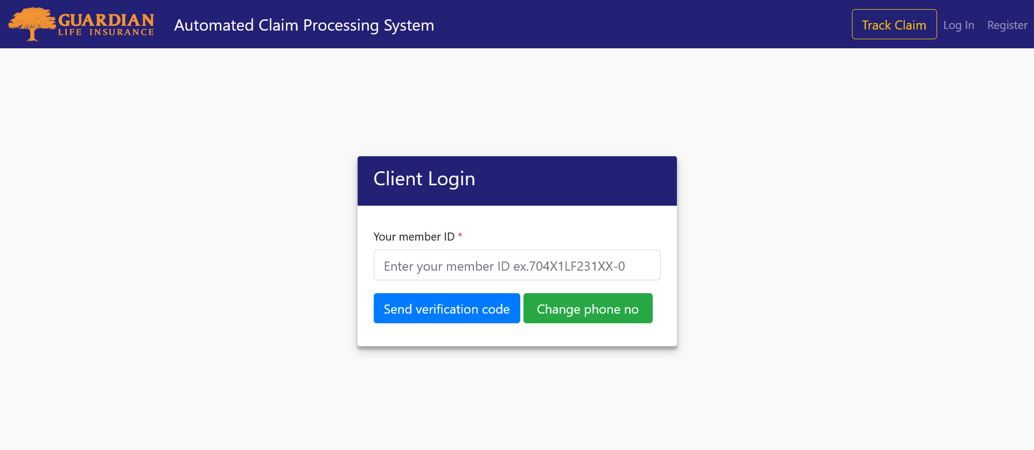
Make an Online Claim
Client Login: Make an online claim by going to the ACPS: Claim Link, insert your GLIL member ID- ex:7123456789-0 (This member ID will be provided by GLIL), and upload the necessary documents for the insurance claim.

Slide 25
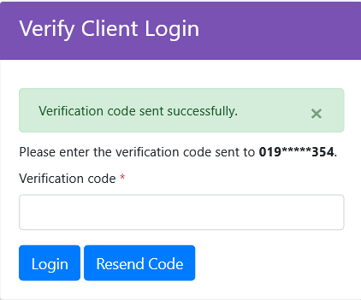
Make an Online Claim
Enter your OTP here to login
Login with OTP: After inserting your GLIL member ID, OTP will be sent to your registered mobile number.

Slide 26
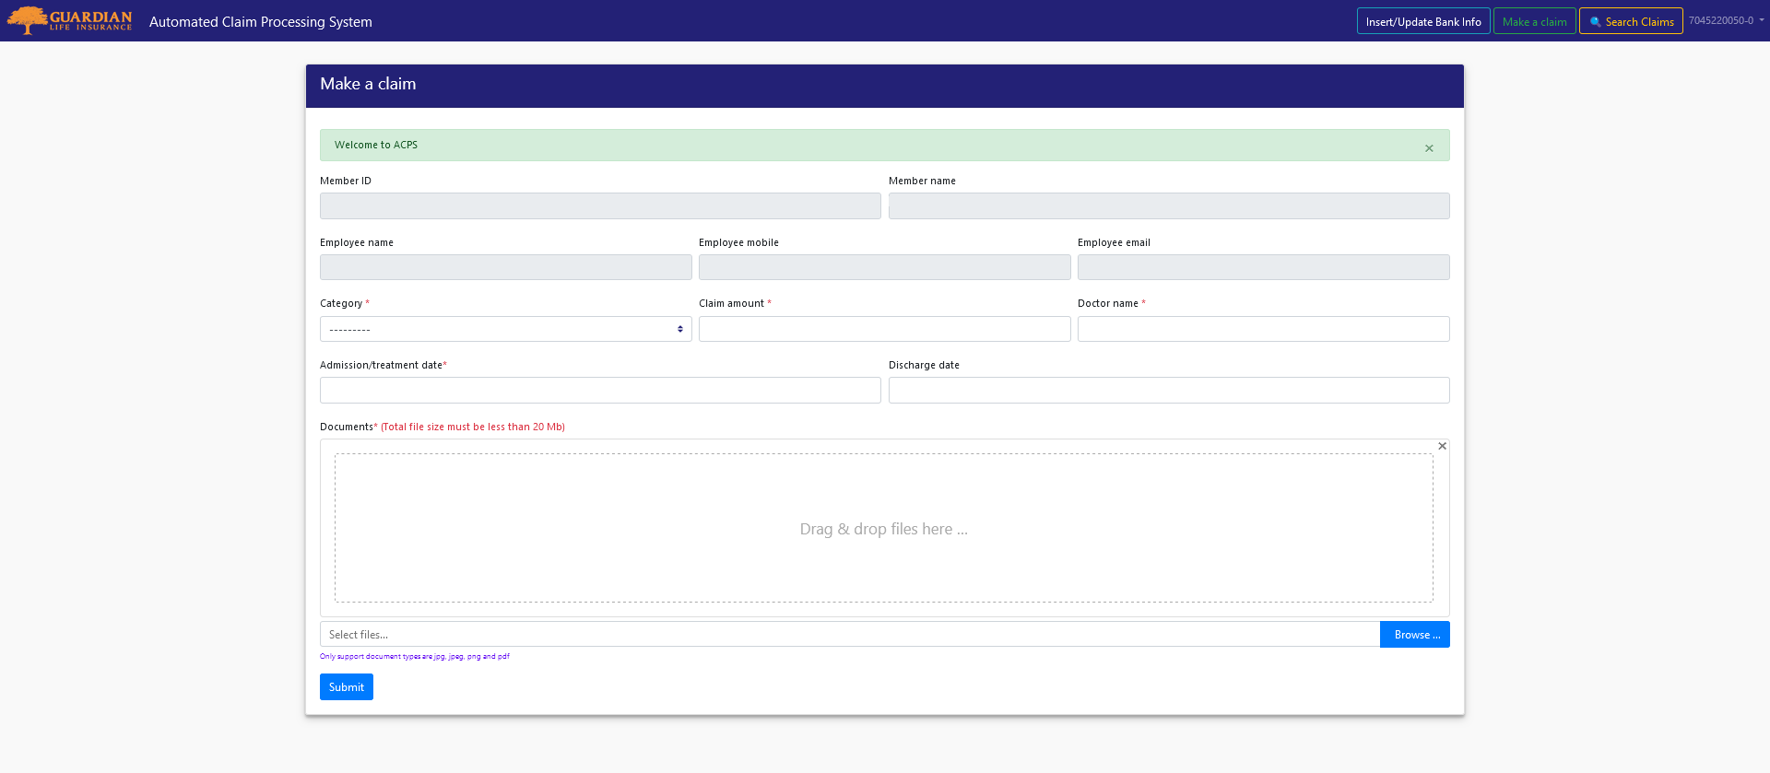
Make an Online Claim
Make a claim: After entering your member id- organization name, employee name, employee mobile number, employee email, member name will be filled automatically.

Slide 27
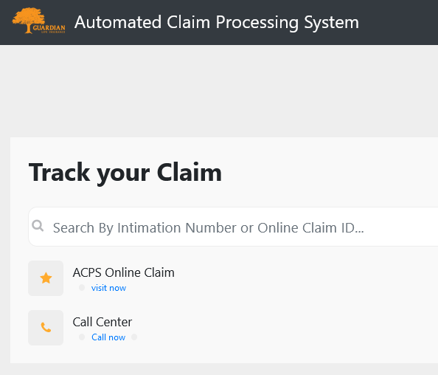
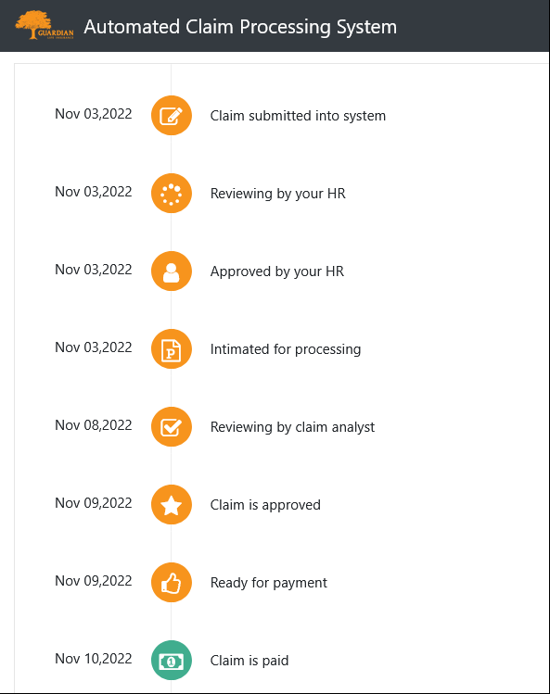
Real-time Claim Tracking
Enter your Claim ID or Intimation number here
This is how the status will show
After the succession of claim submission, you will get a claim ID. Track your claim status by entering your online claim ID (ex: 1234) or you can search with the intimation number( which will be provided via SMS) after the claim process starts. (Intimation number ex: 22-1234)

Slide 28
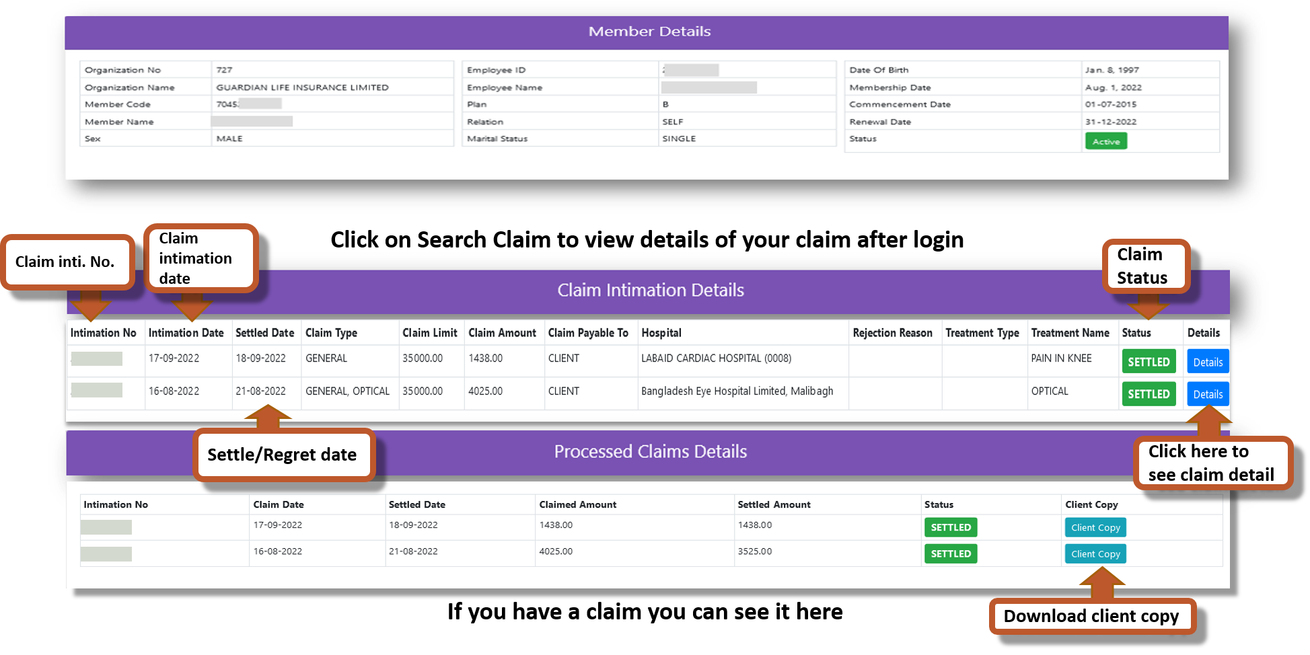
View Claim Details

Slide 29
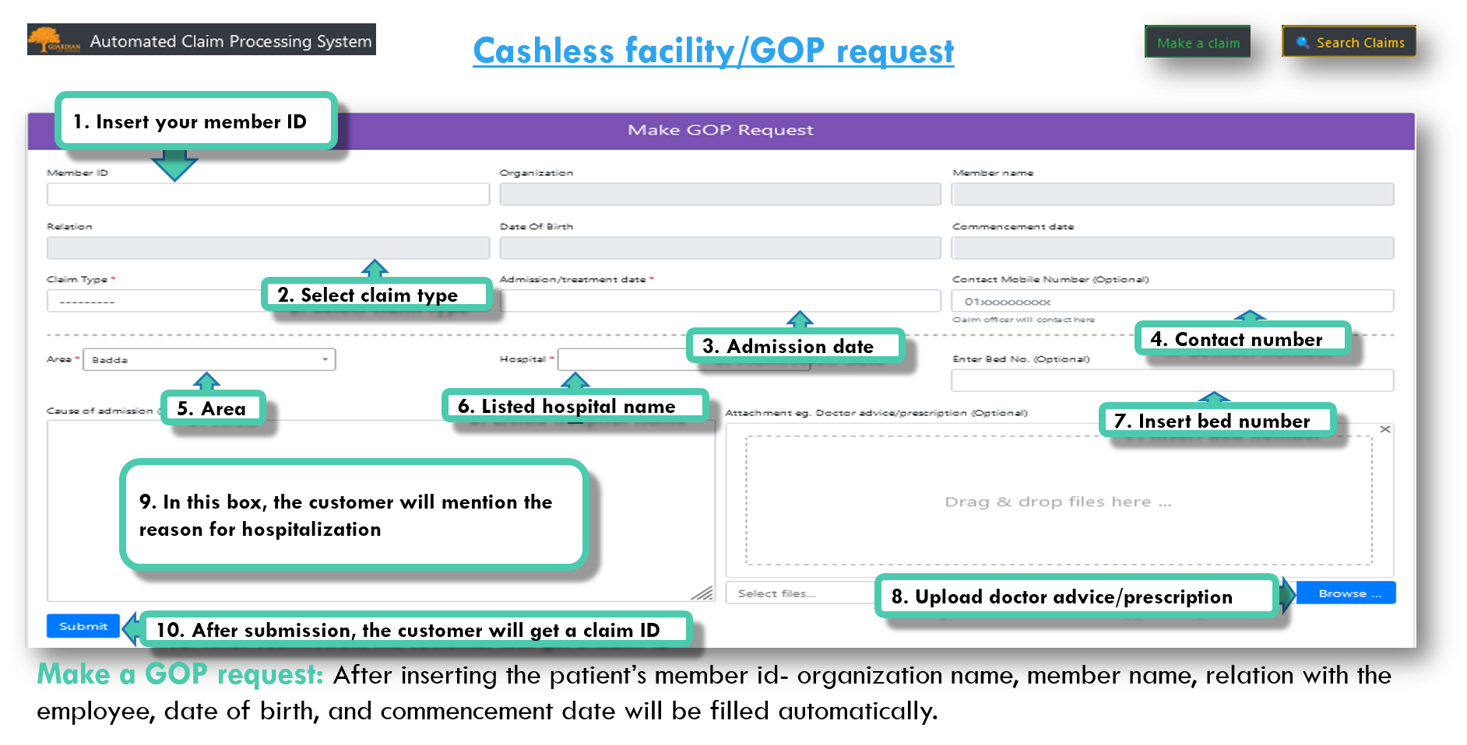

Slide 30
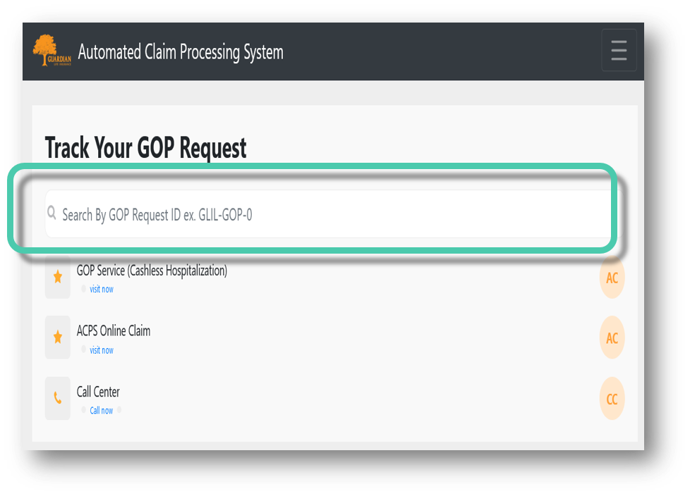
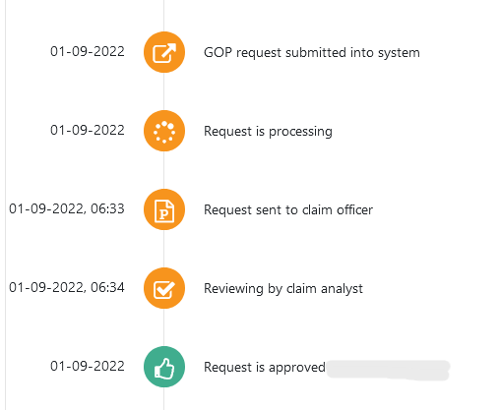
Real-time GOP Tracking
Enter your GOP request ID
This is how the status will show
After the succession of claim submission, you will get a claim ID. Track your GOP status by inserting your GOP claim ID (ex: GLIL-GOP-1234). After successful request submission customer will get a tracking ID and link on his registered mobile number via SMS.

Slide 31
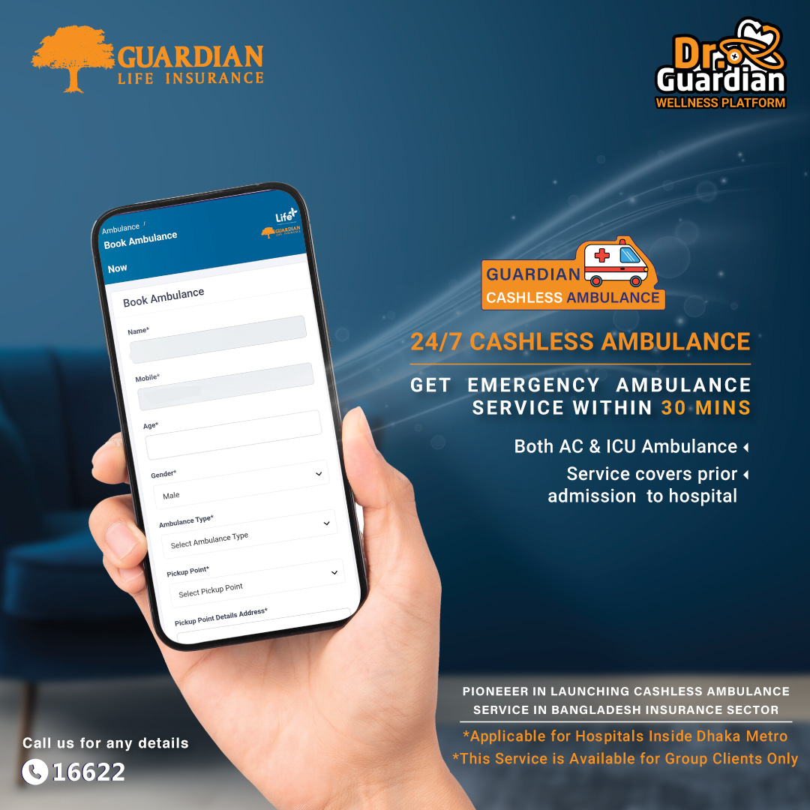
Cashless Ambulance
Key Features of Cashless Ambulance Service:
Request ambulance from MyGuardian App by providing patient's member id, pickup and destination location and hospital name.
Both AC ambulance & ICU ambulance (including stretcher, oxygen & paramedic as required).
Service covers prior admission into hospital.
Applicable for hospitals inside Dhaka metropolitan city.
Reporting time of ambulance is maximum 30 minutes.
Ambulance service is of completely cashless.
One way ambulance service (Pick up

Slide 32
THANK YOU

